Slide 1

Merge sort

Slide 2
Divide-and-Conquer
Divide
Divide the problem into a number of sub-problems
Similar sub-problems of smaller size
Conquer
Conquer the sub-problems
Solve the sub-problems recursively
Sub-problem size small enough to solve the problems in straightforward manner
Combine
Combine the solutions of the sub-problems
Obtain the solution for the original problem

Slide 3
Merge Sort Approach
To sort an array A[low . . High]:
Divide
  Divide the n-element sequence to be sorted into two subsequences of n/2 elements each
Conquer
  Sort the subsequences recursively using merge sort
  When the size of the sequences is 1 there is nothing more to do
Combine
  Merge the two sorted subsequences

Slide 4
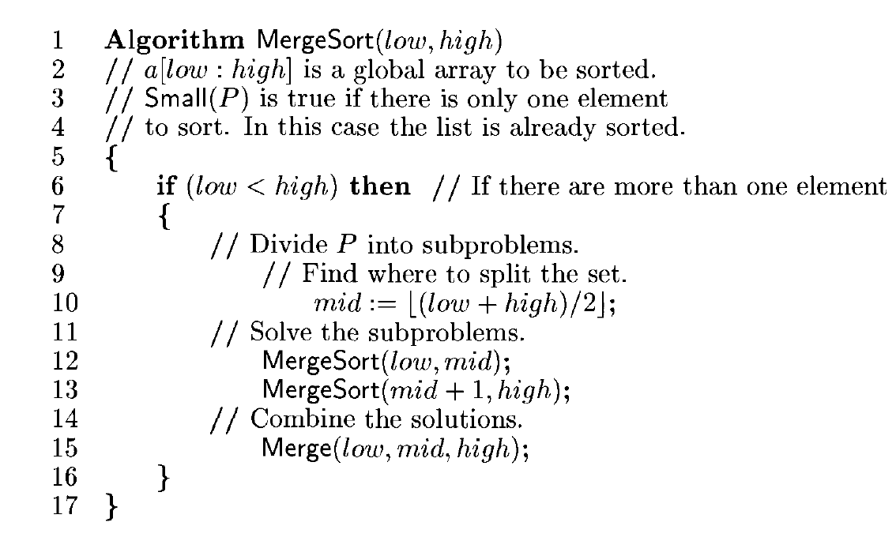

Slide 5
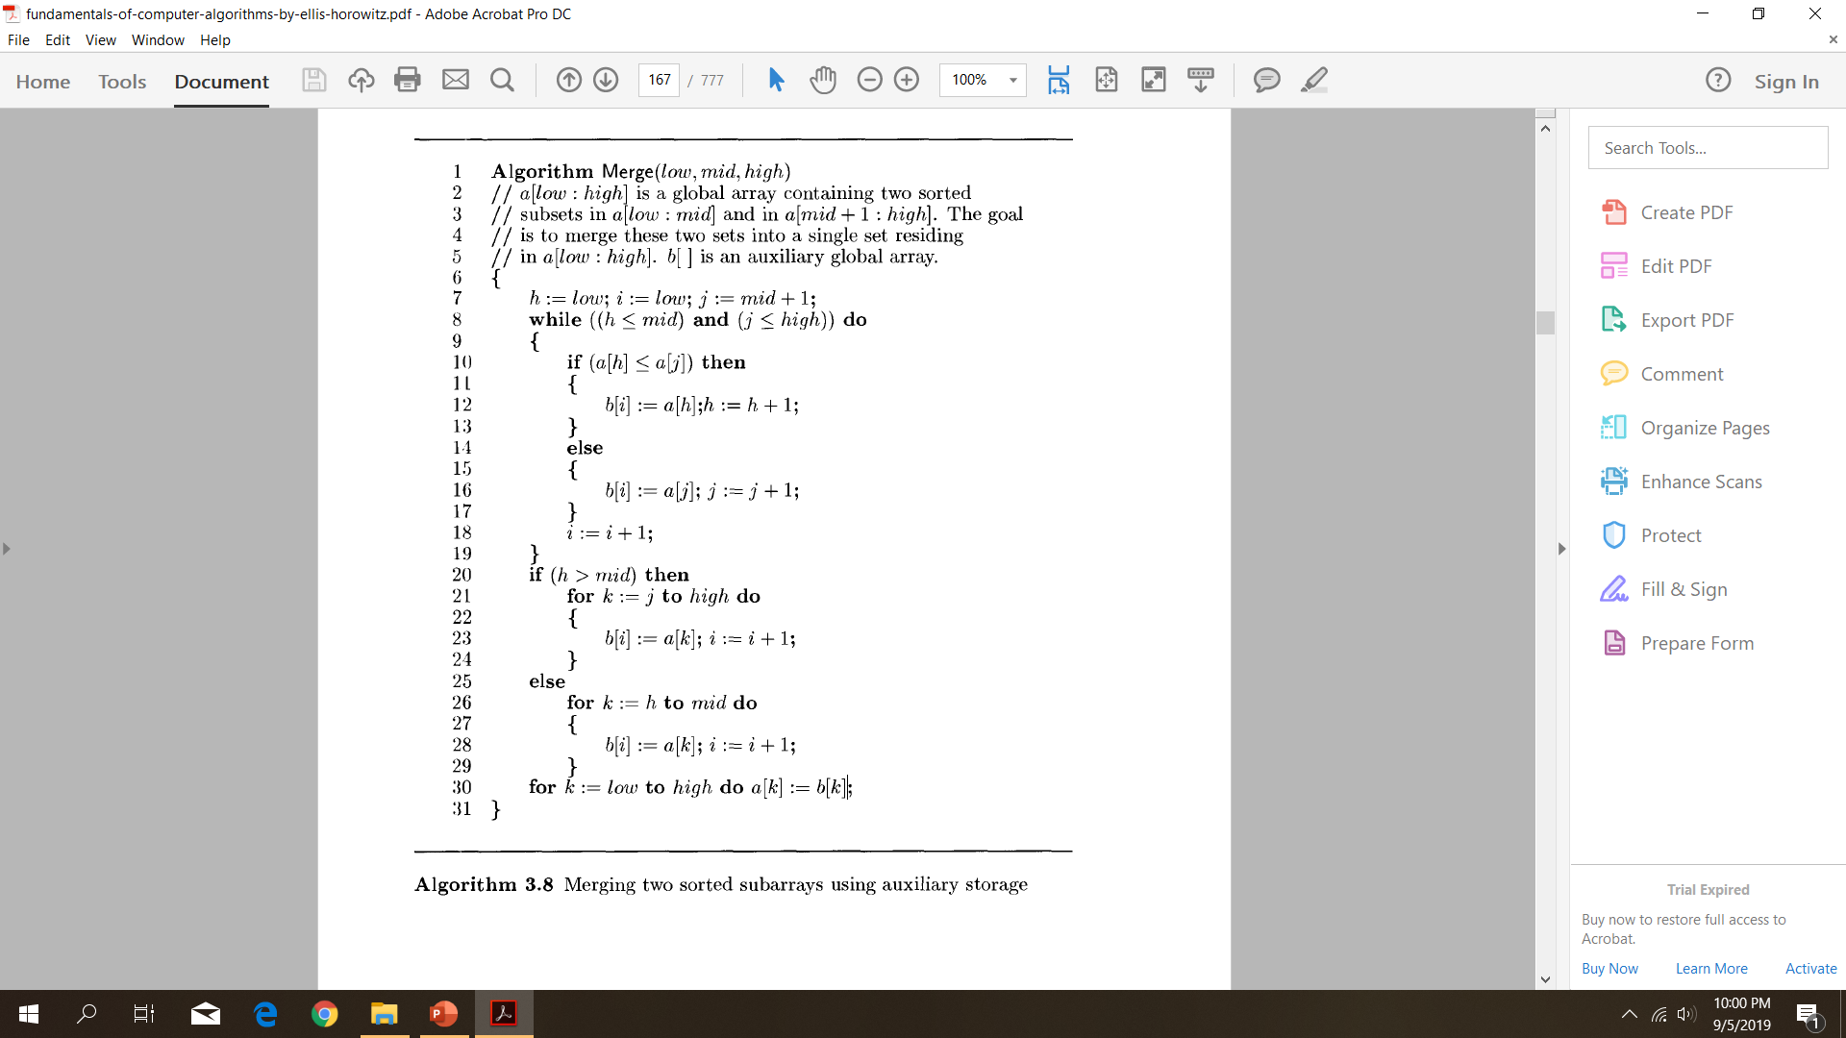

Slide 6
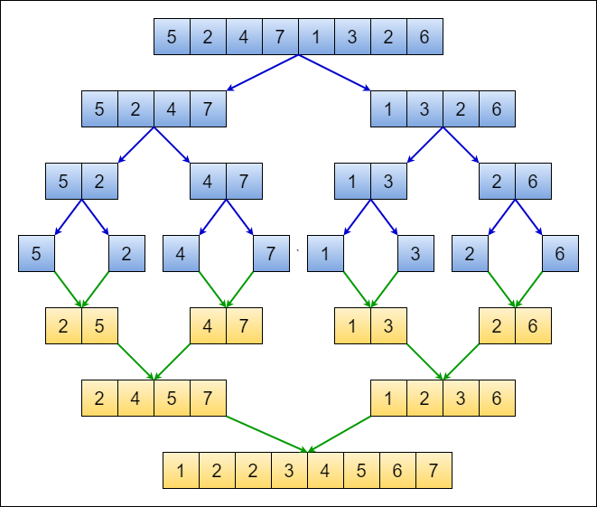

Slide 7
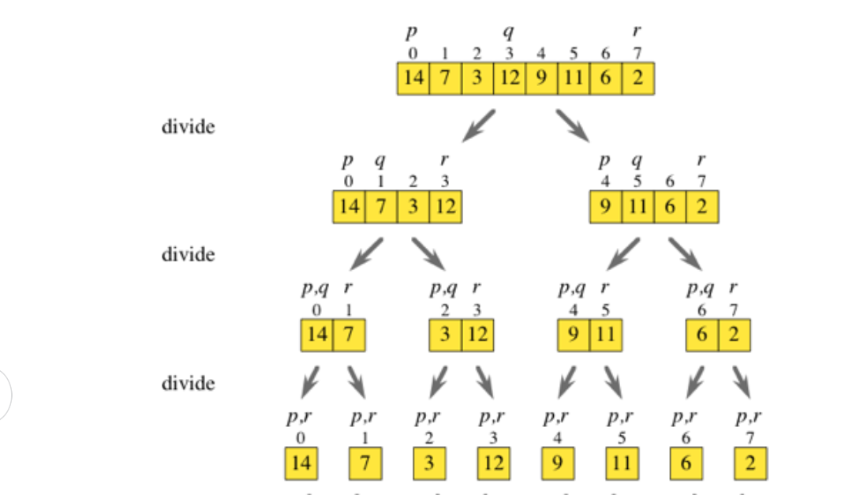

Slide 8
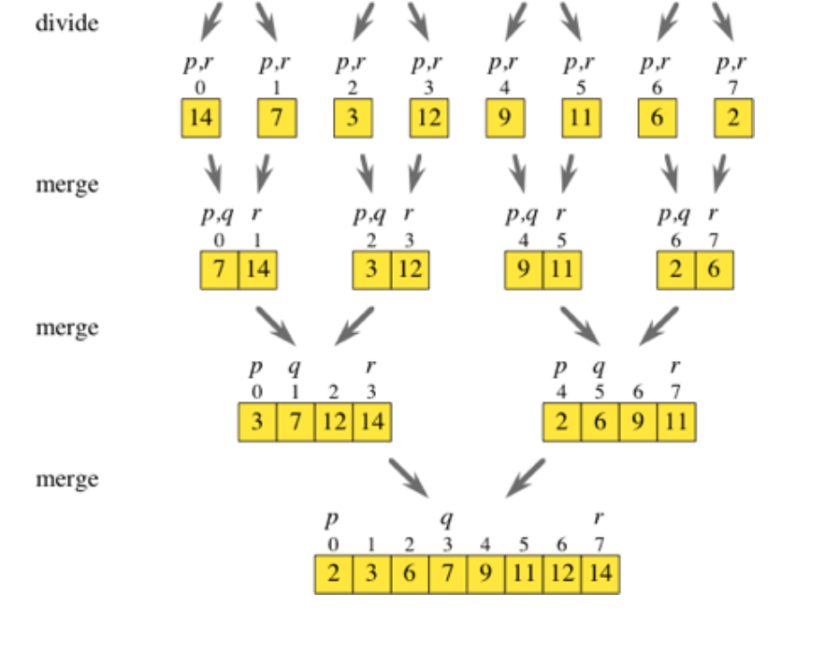

Slide 9
Example 1
a[l:10]= (310, 285,179,652,351,423,861, 254, 450,520).

Slide 10
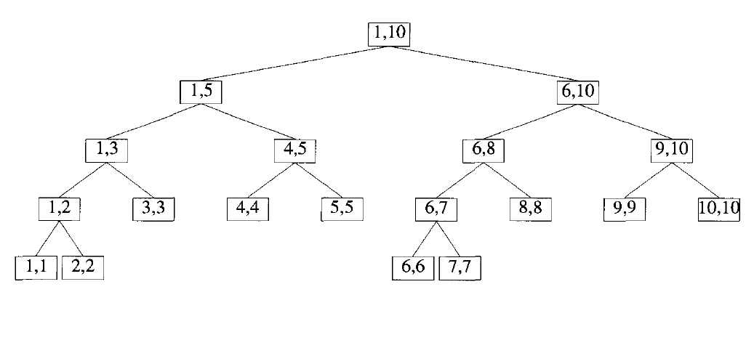
Example
a[l:10]= (310, 285,179,652,351,423,861, 254, 450,520).

Slide 11
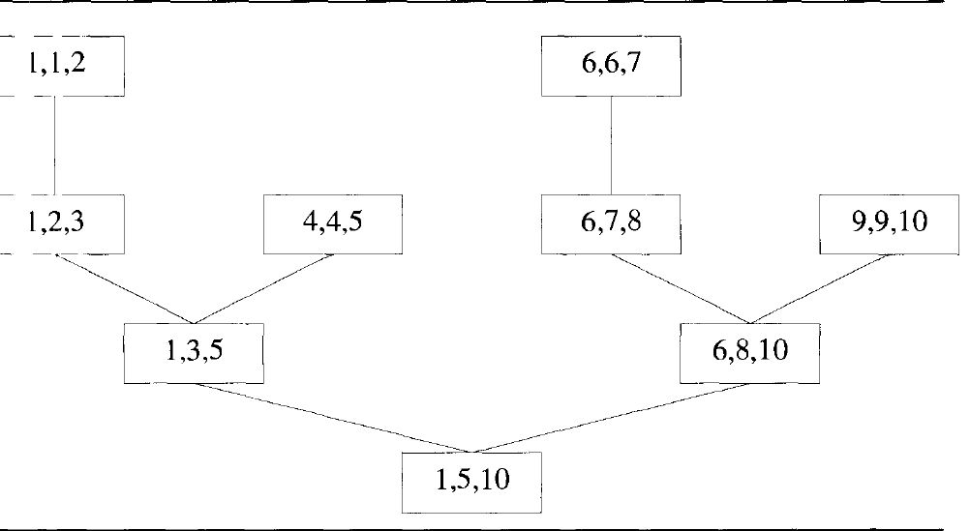

Slide 12

Example 2
16,9,18,22,3

Slide 13
Example 3

Slide 14



.
Example 2 elements to sort : 1,6,3,2,7,5,8,4. We need to sort this array using merge sort

Slide 15





Slide 16
Example 3
2 | 6 | 11 | 4 | 5 | 7

Slide 17
Time complexity of merge sort = O ( n log n)
Recurrence relation of merge sort a ; n=1
T(n)= {
2T(n/2)+cn ;n>1 a,c are constants

